Slide 1
LOAN APPROVAL
GOLD ATLANTIS

Slide 2
Analysis:-
Descriptive Analysis
Predictive Analysis
Prescriptive Analysis

Slide 3
Descriptive Analysis: Describes the relationship between the columns
Single column analysis(Univariate)
Two column analysis(Bivariate)
Multiple column analysis(Multivariate)

Slide 4
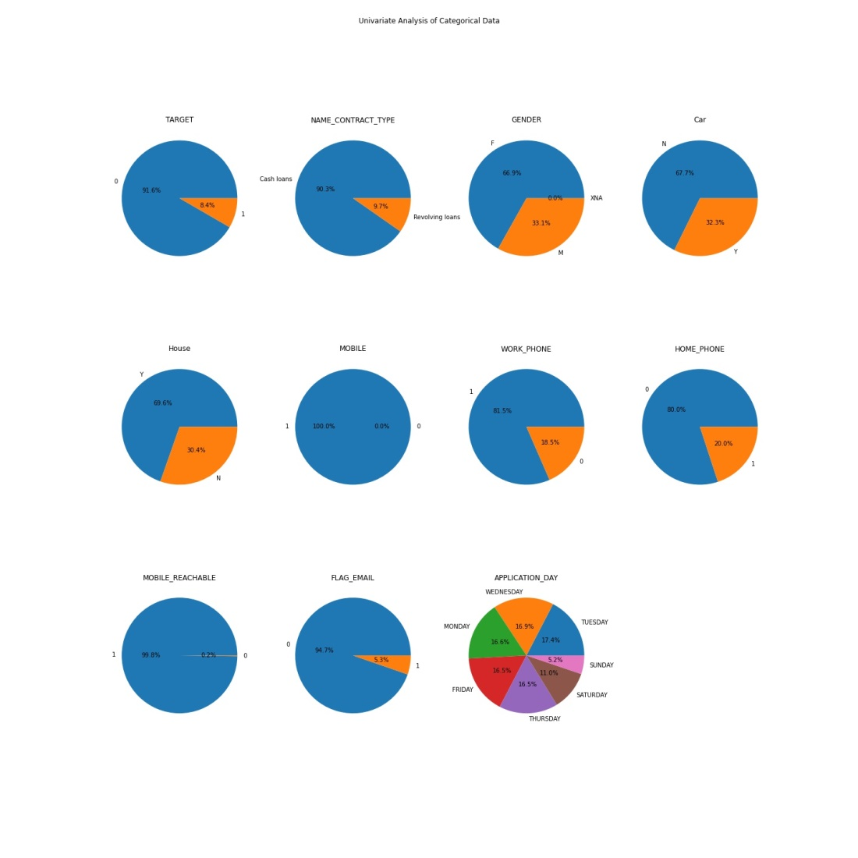
Univariate Analysis FOR CATEGORICAL DATA :-
Notes:
Categorical data is a type of data which is countable, totally we have 16 columns with categorical data and we have used pie chart , count plot to draw the graphs.

Slide 5
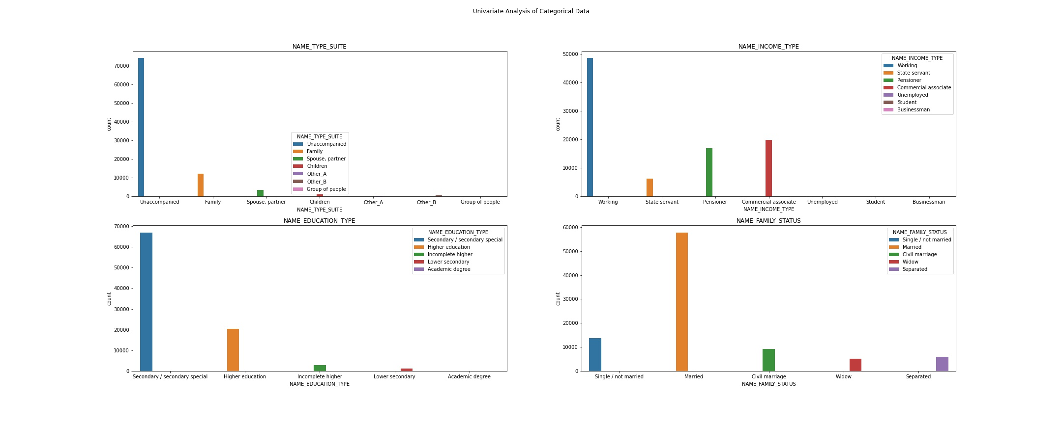
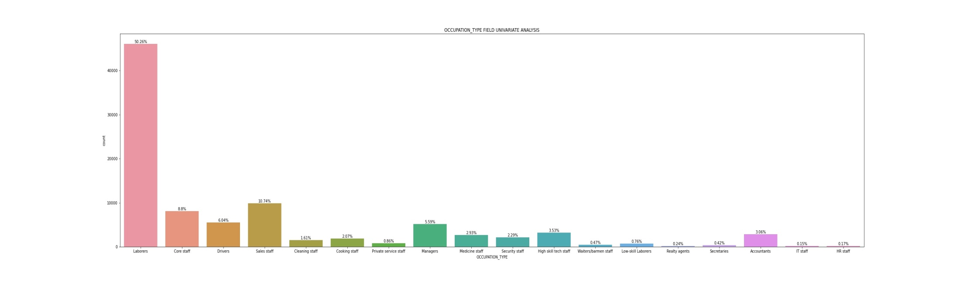

Slide 6
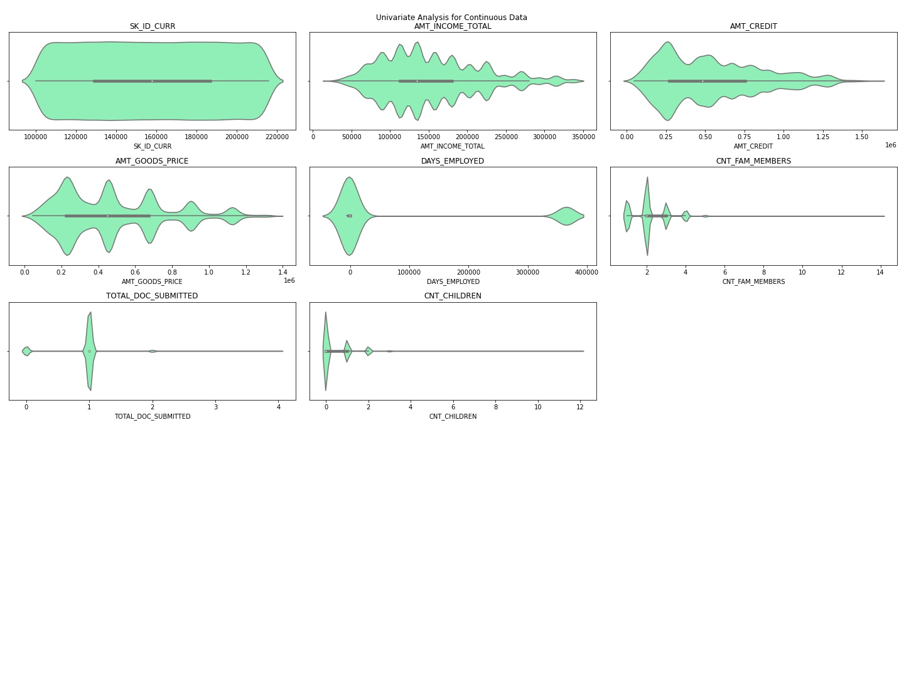
FOR CONTINUOUS DATA:-
Notes:
Continuous data is a type of data which is measurable , here we have 8 columns with continuous data and we have used violin plot to draw the graph here.

Slide 7
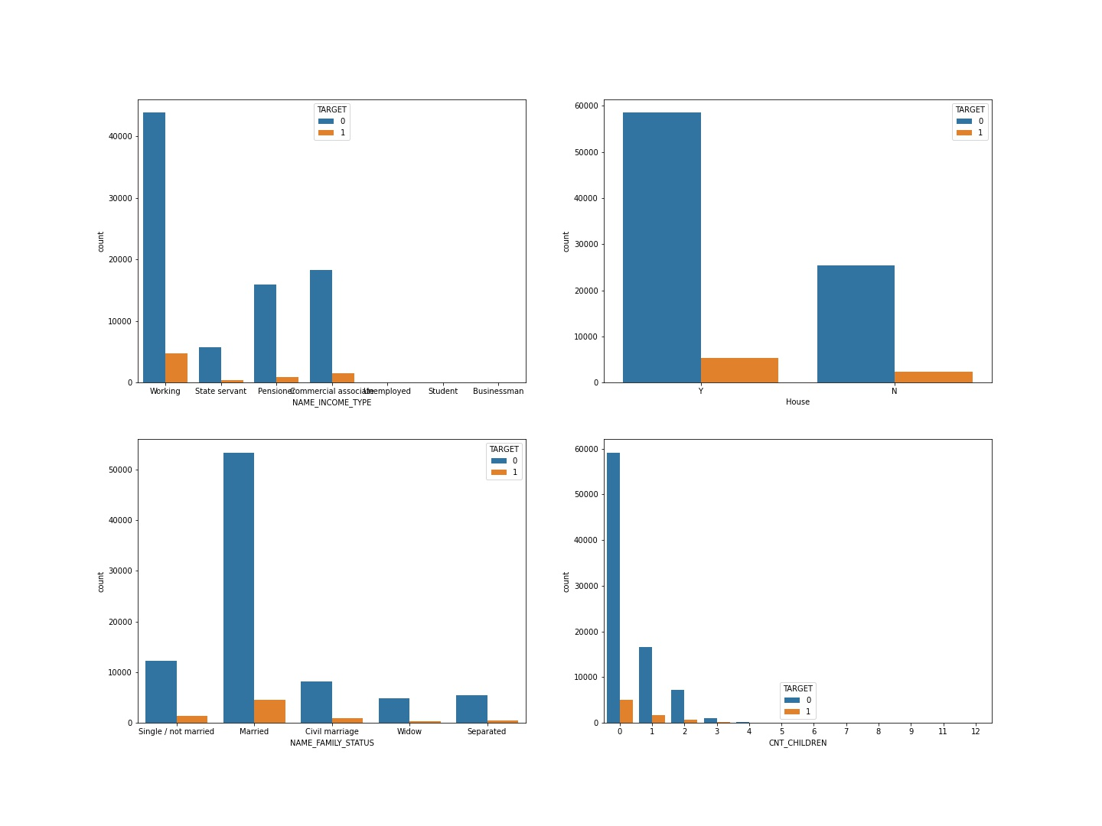
Bivariate Analysis
Notes:
With Target as a factor , we are comparing other columns with it and count plot is used to draw the graphs.

Slide 8
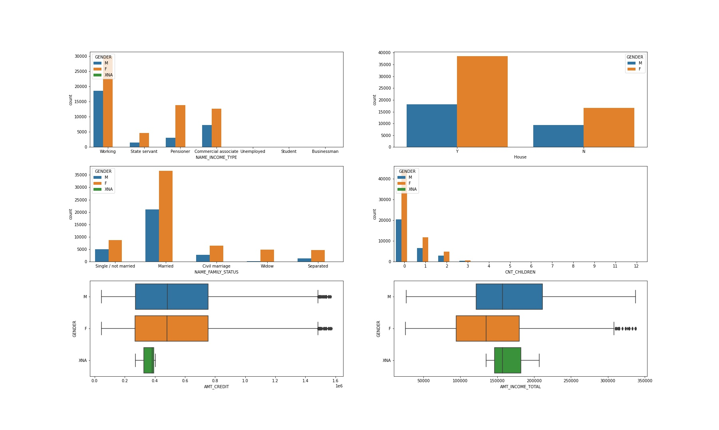
Notes:
With Gender as a factor , we are comparing other columns with it and count & box plots are used to draw the graphs here.

Slide 9
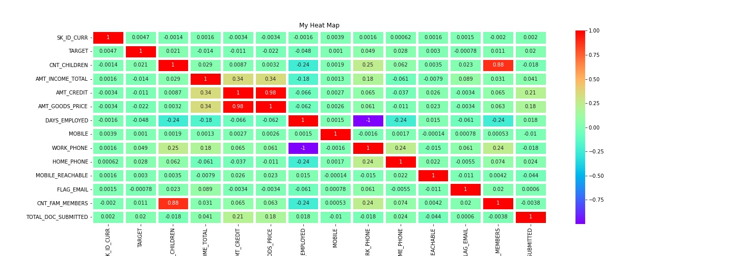
Multivariate Analysis
Notes:
Heat map shows the correlation between all the possible columns and it is multivariate analysis.

Slide 10
Number of clients
Total clients-1,00,000
Eligible clients-34,082
Defaulter-57,500
Notes:
The rest values are extreme values , which are neglected during the analysis

Slide 11
Predictive Analysis:-
The eligible clients are selected based on considering the following criteria:-
They should not be student and unemployed for INCOME TYPE
They should have submitted documents
Their phone must be reachable
Count of children less than 4
And their target should be zero( i.e. they should not make late payment)
Especially for pensioners INCOME_TYPE ,the selection criteria should be high comparatively, because of their age factor ,which might increase the risk of repayment
Notes:
This conclusion is derived after doing numerous analysis with the dataset . And these are the criteria ,which eligible clients meet.

Slide 12
Prescriptive Analysis:-
To increase the number of eligible clients to get loan , the following criteria has to be followed:-
Documents should be submitted
Make the client to avoid late payment
The mobile phone should be reachable
Income of the client should be eligible to take the desired credit amount
Notes:
And these criteria should be considered , to minimize the defaulter.

Slide 13
Thank You!

